Slide 1


Logistic Regression
A Fundamental Machine Learning Model for Binary Classification
By- Miraj Deep Bhandari

Slide 2


What is Logistic Regression?
Machine Learning Model
A statistical method specifically designed for binary classification tasks where the target variable has two categories.
Binary Classification
Predicting an outcome that belongs to one of two classes, such as 0 or 1, True or False, or Yes or No.
Probability Estimation
The core goal is to predict the probability that a given input instance belongs to a specific category.
0 vs 1 Classification

Slide 3




Real-World Applications
Email Filtering
Financial Security
Classifying incoming messages as "Spam" or "Not Spam" based on content features.
Detecting "Fraudulent" vs. "Legitimate" transactions in real-time.
Medical Diagnosis
Oncology
Predicting the presence of a specific "Disease" or "No Disease" from patient data.
Classifying medical imaging or biopsy results as "Malignant" or "Benign."

Slide 4

Linear vs. Logistic Regression
Feature
Linear Regression
Logistic Regression
Model Shape
Straight Line
S-Shaped Curve (Sigmoid)
Output Type
Continuous Values
Probabilities (0 to 1)
Binary Data Fit
Poor fit; can predict values < 0 or > 1
Perfect fit for binary outcomes
Primary Use
Predicting Quantities (e.g., Price)
Classification (e.g., Yes/No)

Slide 5
Can't I Use the Same Straight Line to Predict,Like in Linear Regression?
Let's Try It and See the Issues.

Slide 6
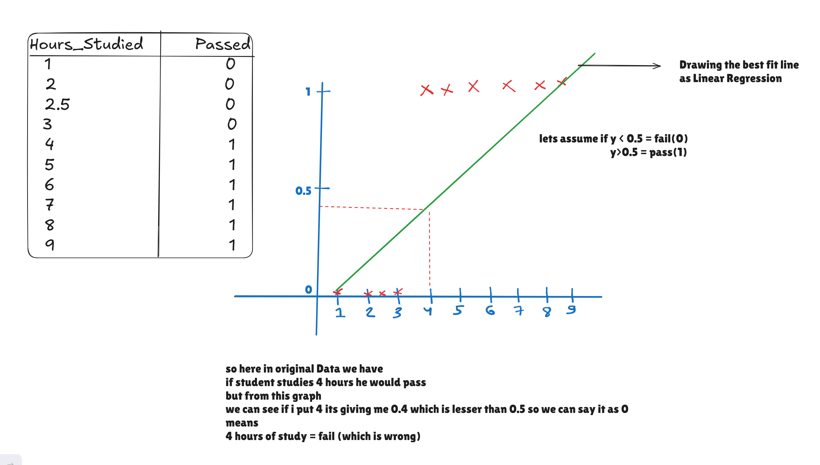
Case 1:

Slide 7
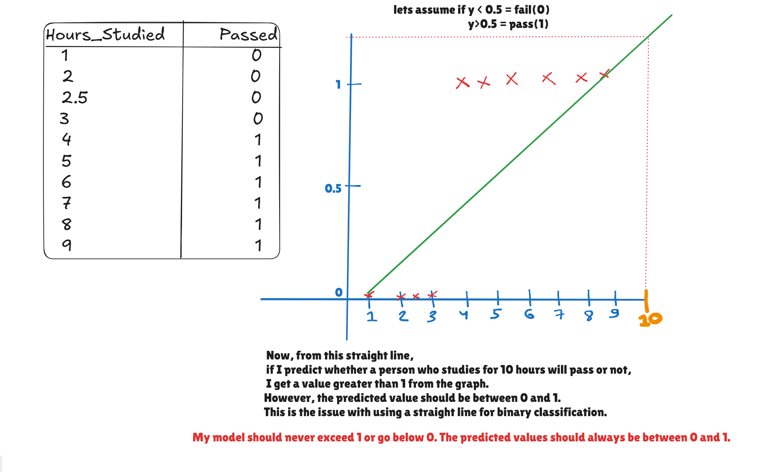
Case 2:

Slide 8
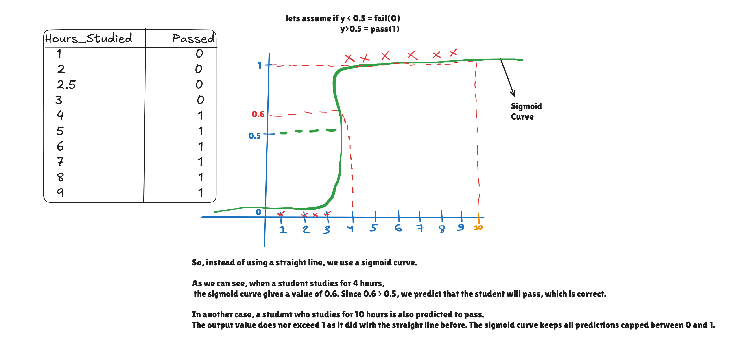
Solution : Replacing the Straight Line with Sigmoid Curve

Slide 9
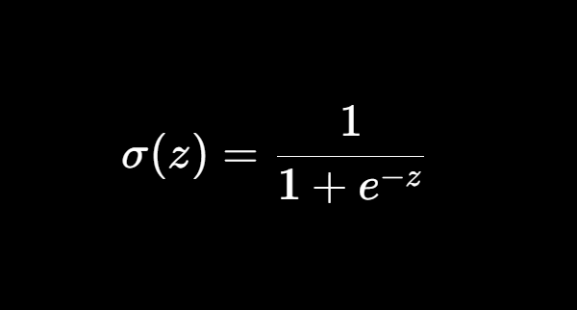


The Sigmoid Function
MATHEMATICAL DEFINITION
FUNCTION CHARACTERISTICS
Output Range is Between 0 and 1
The S-shaped curve that maps any real-valued number into a probability range between 0 and 1.
As $x→+∞$, the output approaches 1.
As $x→−∞$, the output approaches 0.
z = m
x + b
Z is the continuous value coming from the straight-line equation. We then pass it to the sigmoid function, which caps the output value between 0 and 1.

Slide 10
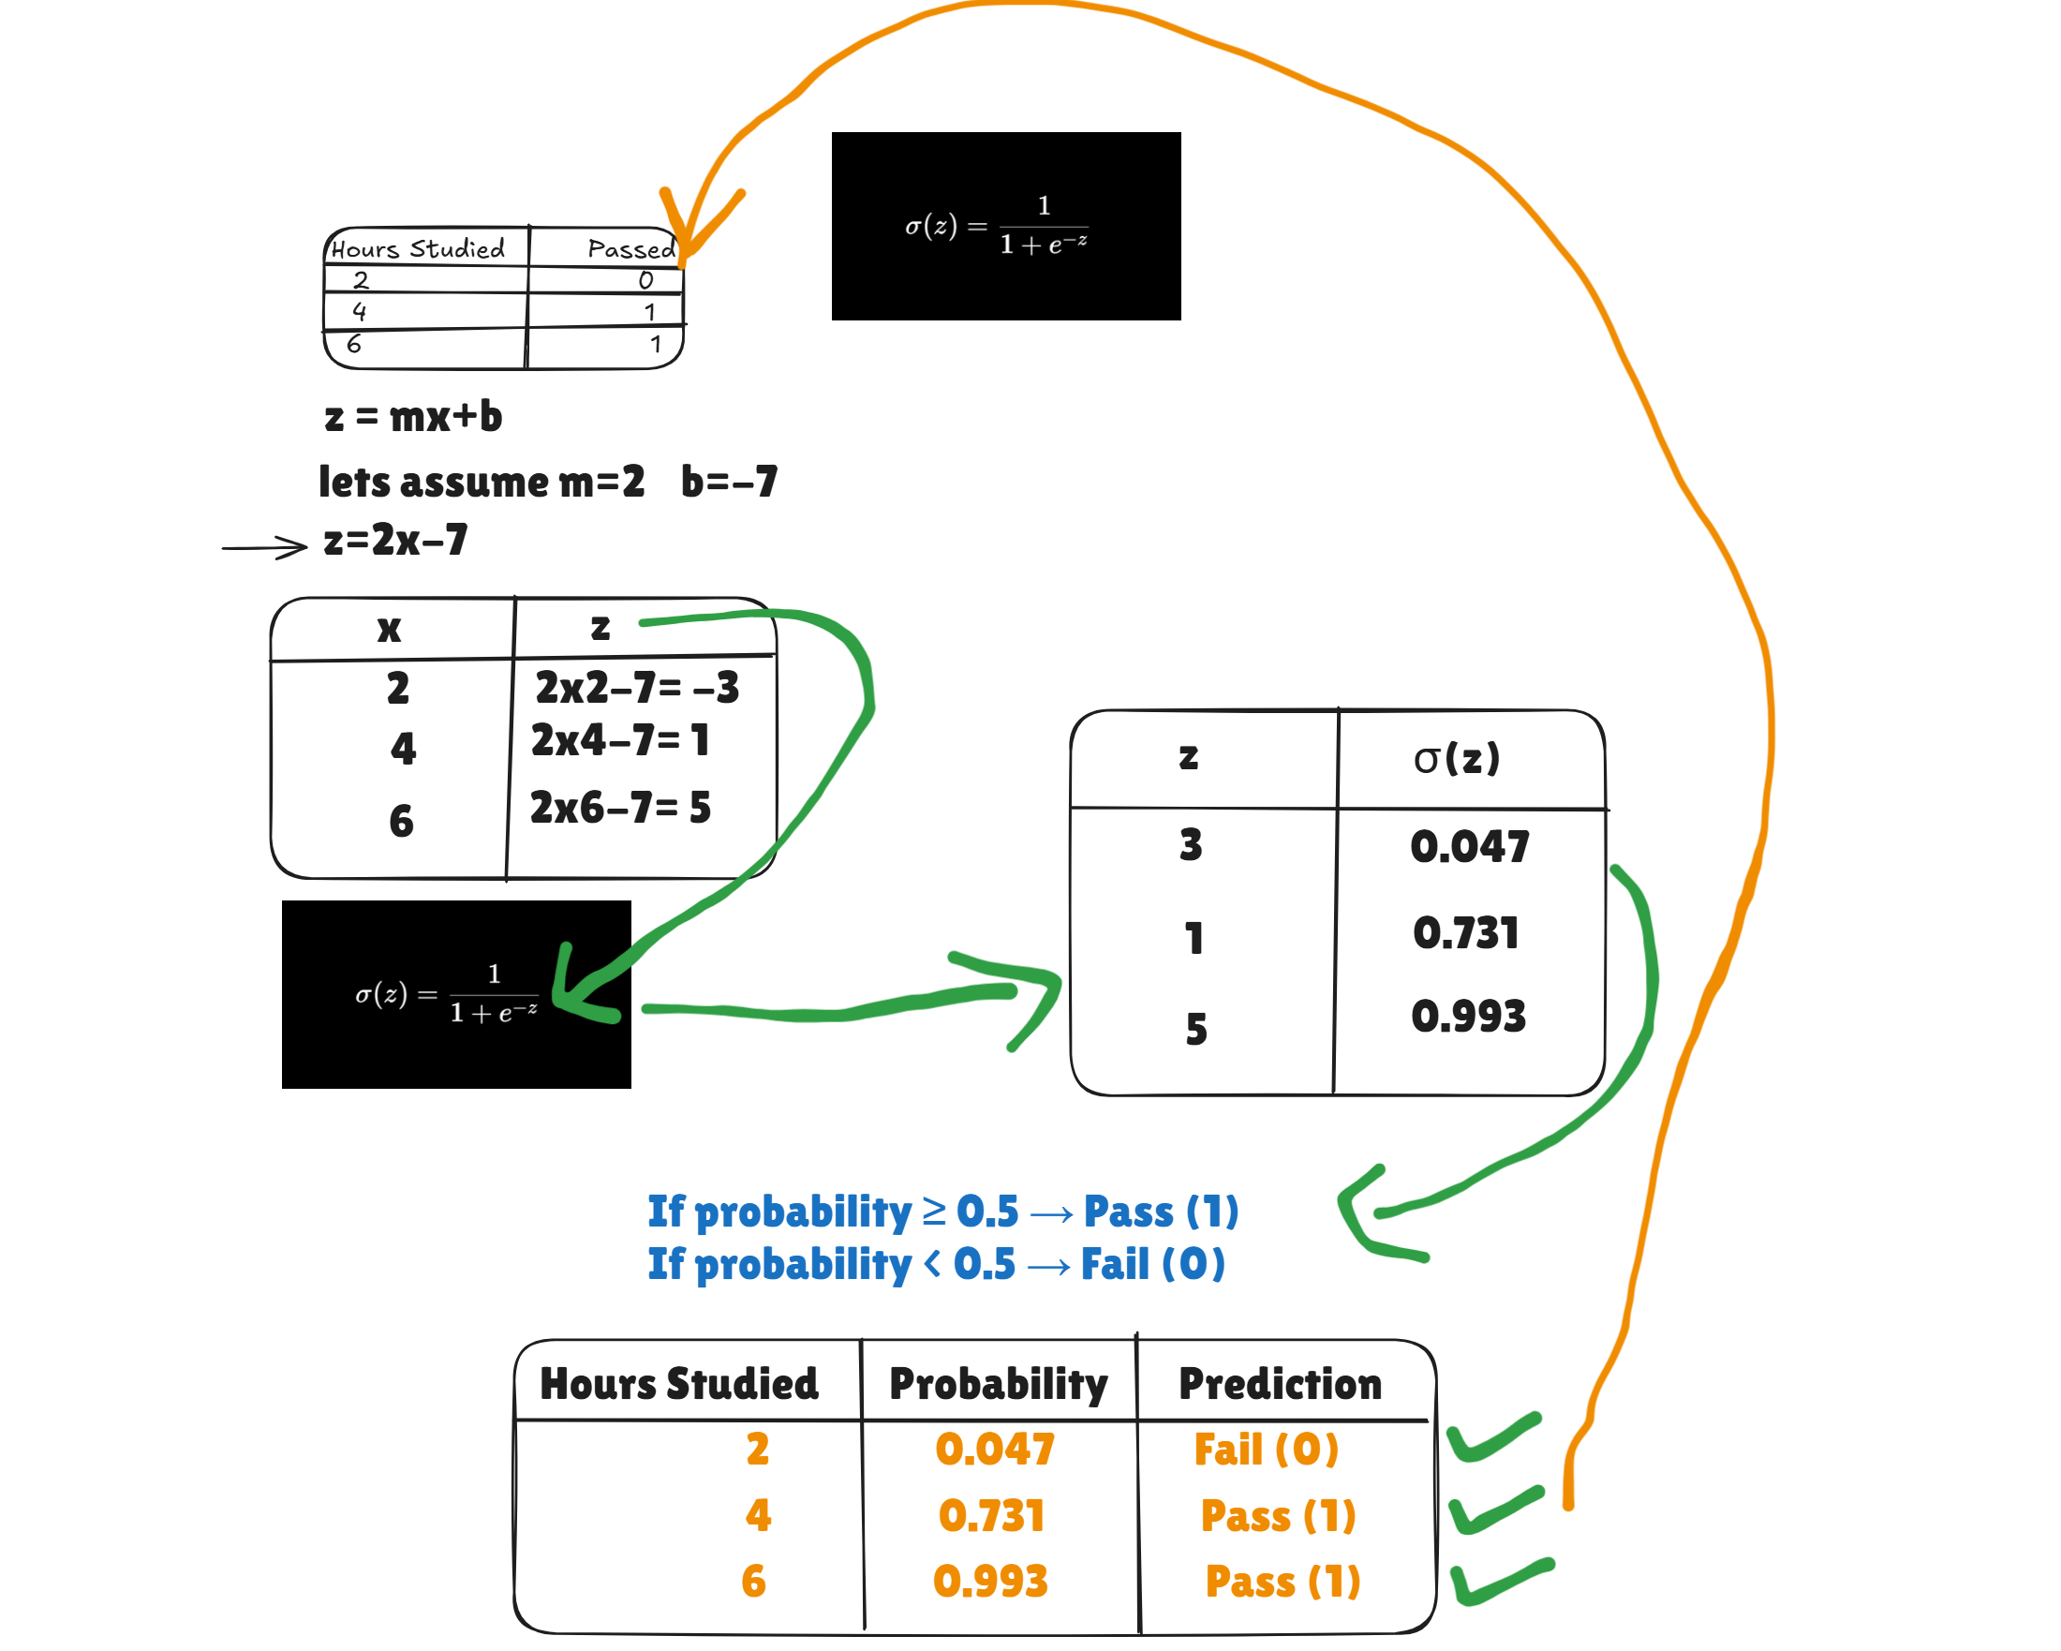
The Sigmoid Function Intution

Slide 11
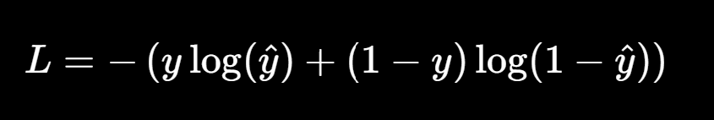
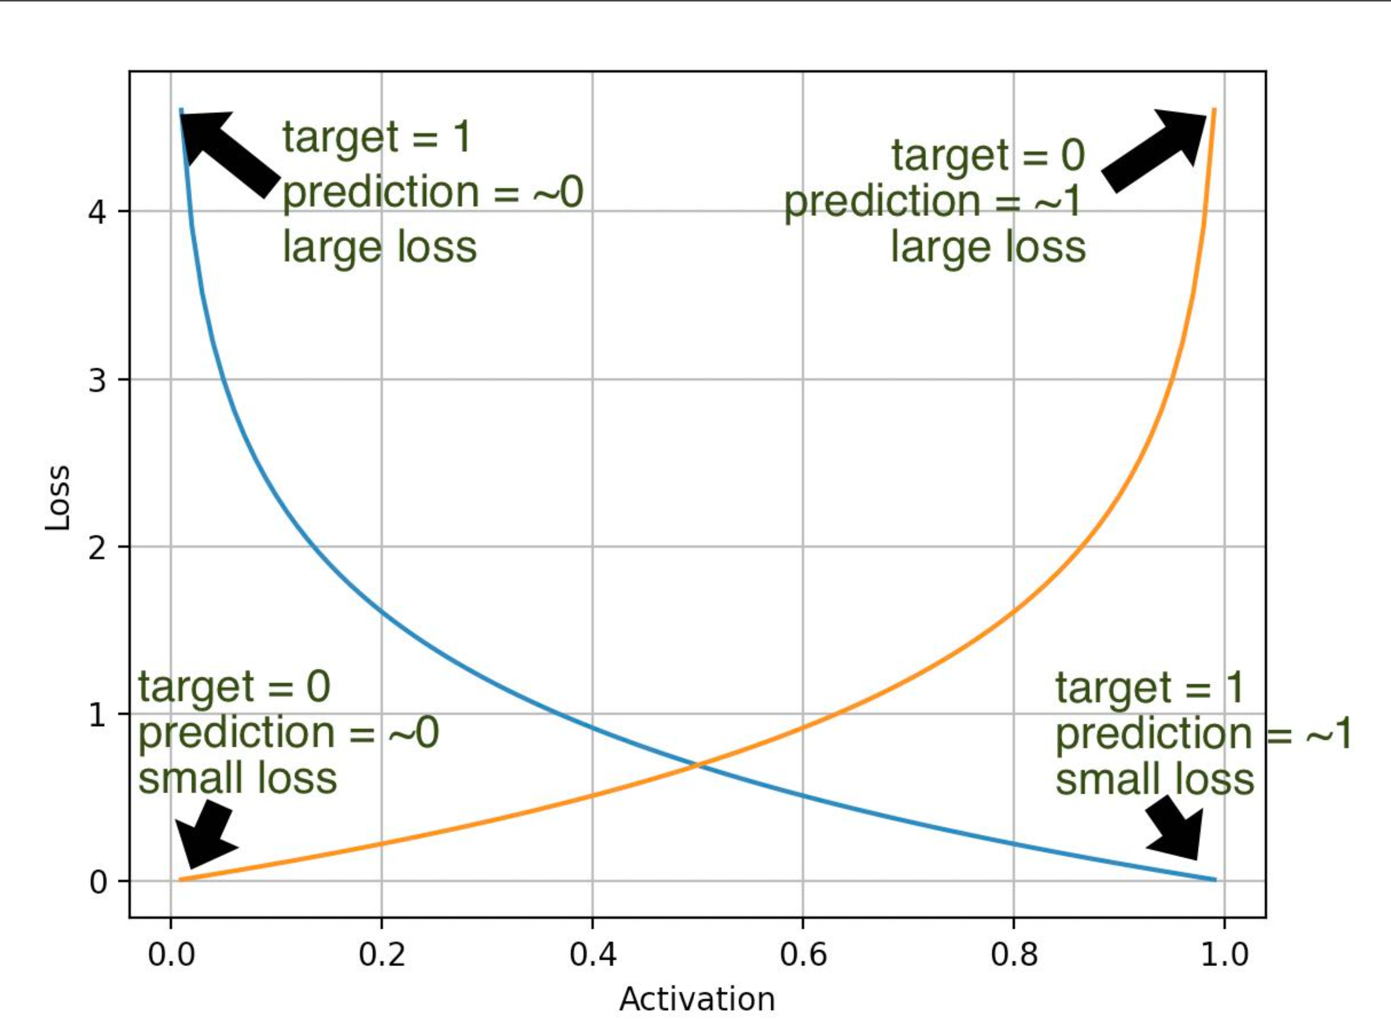
The Loss Function
Logistic Regression Loss Function (Binary Cross-Entropy / Log Loss)

Slide 12

Mathematical Representation
1. LINEAR COMBINATION
z = m
x + b
w: Weights (Parameters)
x: Input Features
b: Bias (Intercept)
2. FINAL PREDICTION (PROBABILITY)
ŷ = σ(z) = 1 / (1 + e
^{-z}
)
ŷ: Predicted Probability [0, 1]
σ: Sigmoid Activation Function

Slide 13


Making Predictions
The output of the sigmoid function, ŷ, is interpreted as the probability that the input belongs to the positive class (Class 1).
Probability Condition
Predicted Class
ŷ ≥ 0.5
Class 1
(e.g., Positive)
ŷ < 0.5
Class 0
(e.g., Negative)
The Decision Boundary is the point where the model transitions from one class to another, typically at the 0.5 probability threshold.
Threshold = 0.5 Linear Separation in Feature Space

Slide 14



Training the Model
The Objective
The primary goal is to find the optimal parameters—weights (w) and bias (b)—that allow the sigmoid curve to fit the training data as accurately as possible.
The Cost Function
A mathematical tool used to measure how far off our predictions are from the actual values. It quantifies the error for a given set of parameters.
Optimization Process
By iteratively minimizing the cost function, we update the weights and bias to improve the model's prediction accuracy and overall performance.

Slide 15
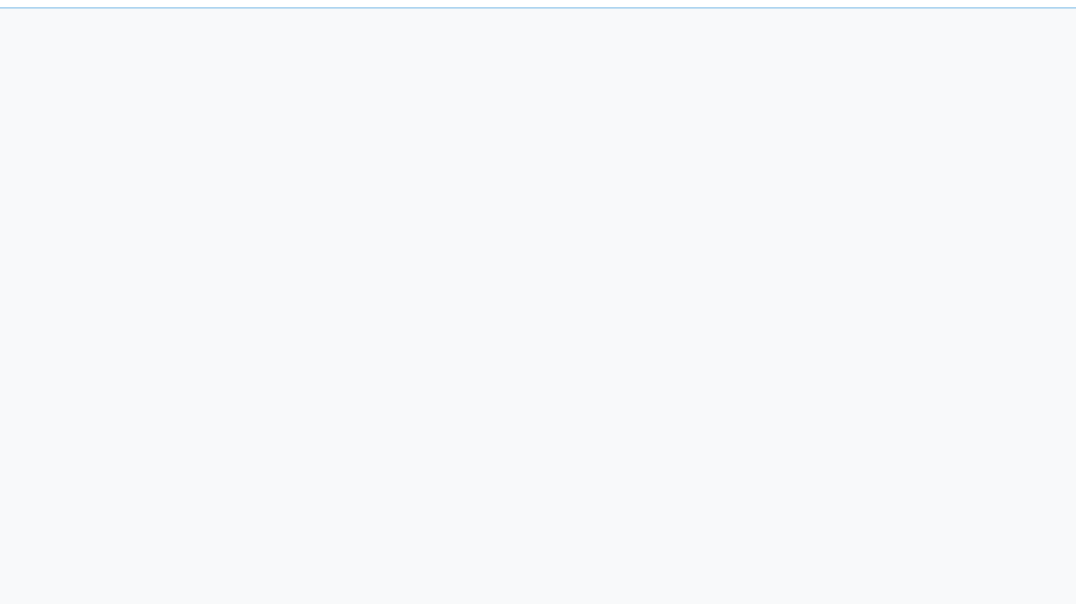




Summary and Conclusion
Logistic regression is the foundational model for binary classification in machine learning.
It utilizes the Sigmoid function to map linear combinations into probabilities between 0 and 1.
Model performance is optimized by minimizing a cost function to find the best weights and bias.

